Slide 1


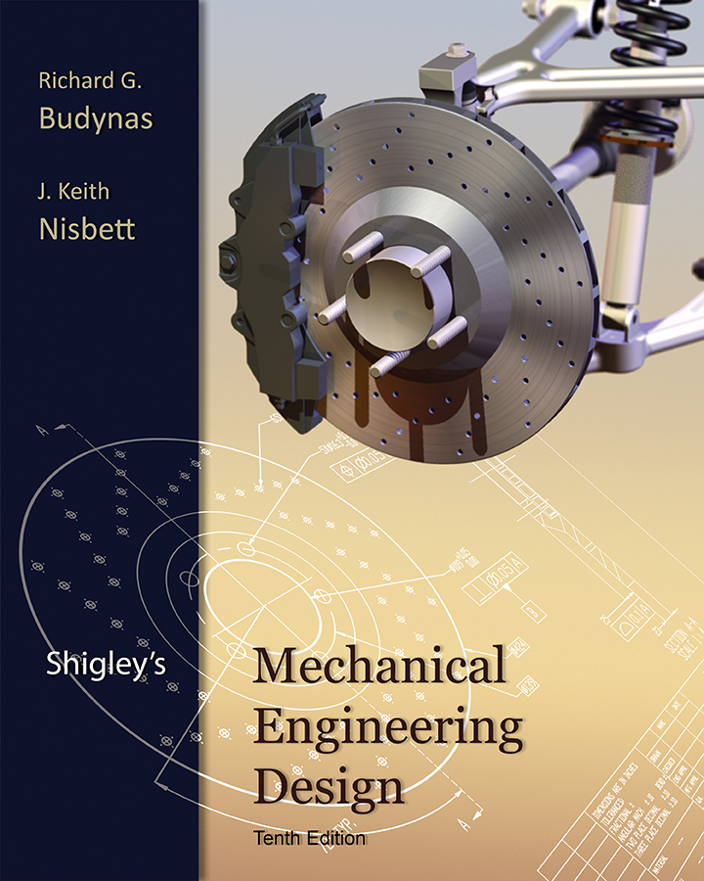
Lecture Slides
Chapter 7
Shafts and Shaft Components
© 2015 by McGraw-Hill Education. This is proprietary material solely for authorized instructor use. Not authorized for sale or distribution in any manner. This document may not be copied, scanned, duplicated, forwarded, distributed, or posted on a website, in whole or part.

Slide 2
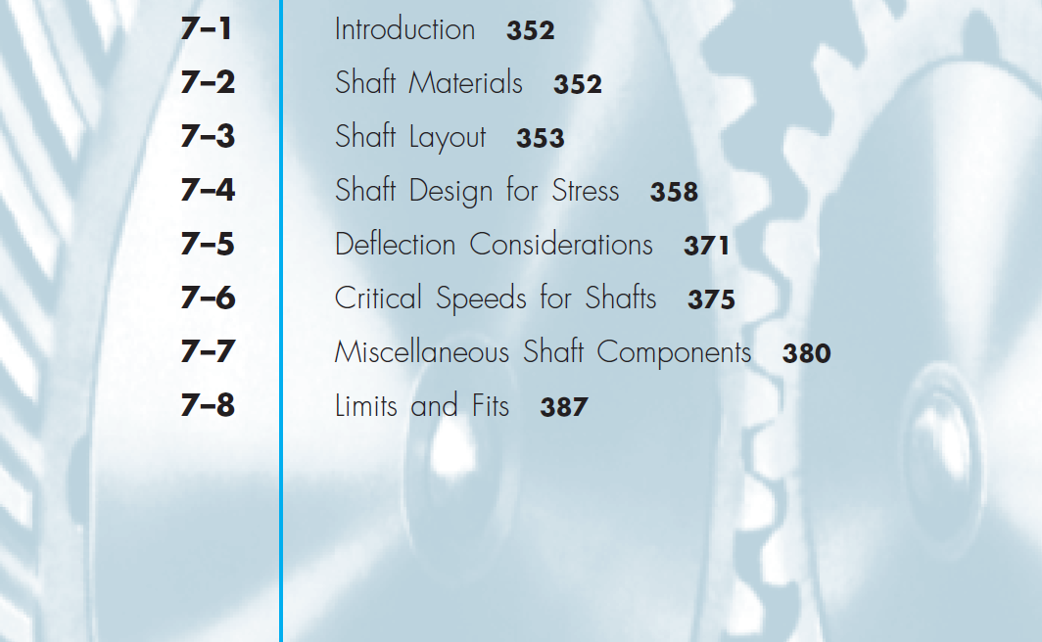
Chapter Outline

Slide 3
Shaft Design
Material Selection
Geometric Layout
Stress and strength
Static strength
Fatigue strength
Deflection and rigidity
Bending deflection
Torsional deflection
Slope at bearings and shaft-supported elements
Shear deflection due to transverse loading of short shafts
Vibration due to natural frequency

Slide 4
Shaft Materials
Deflection primarily controlled by geometry, not material
Stress controlled by geometry, not material
Strength controlled by material property

Slide 5
Shaft Materials
Shafts are commonly made from low carbon, CD or HR steel, such as AISI 1020–1050 steels.
Fatigue properties don’t usually benefit much from high alloy content and heat treatment.
Surface hardening usually only used when the shaft is being used as a bearing surface.

Slide 6
Shaft Materials
Cold drawn steel typical for d < 3 in.
HR steel common for larger sizes. Should be machined all over.
Low production quantities
Lathe machining is typical
Minimum material removal may be design goal
High production quantities
Forming or casting is common
Minimum material may be design goal

Slide 7
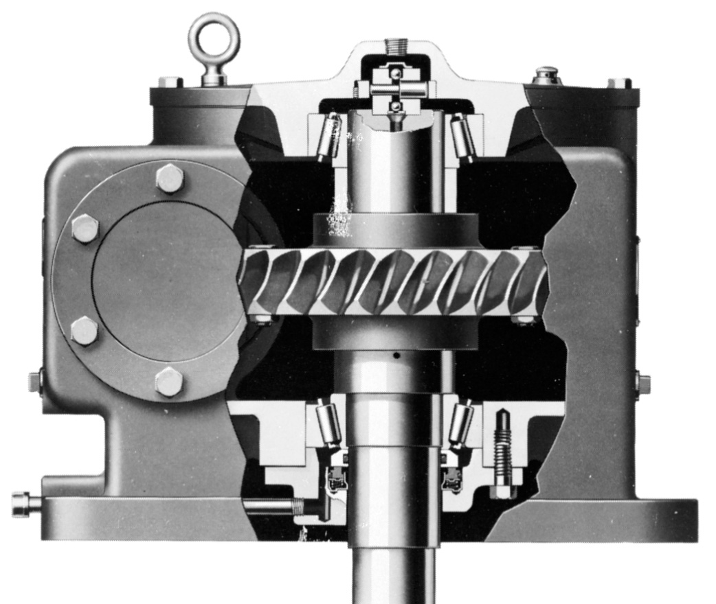
Shaft Layout
Issues to consider for shaft layout
Axial layout of components
Supporting axial loads
Providing for torque transmission
Assembly and Disassembly
Fig. 7–1

Slide 8
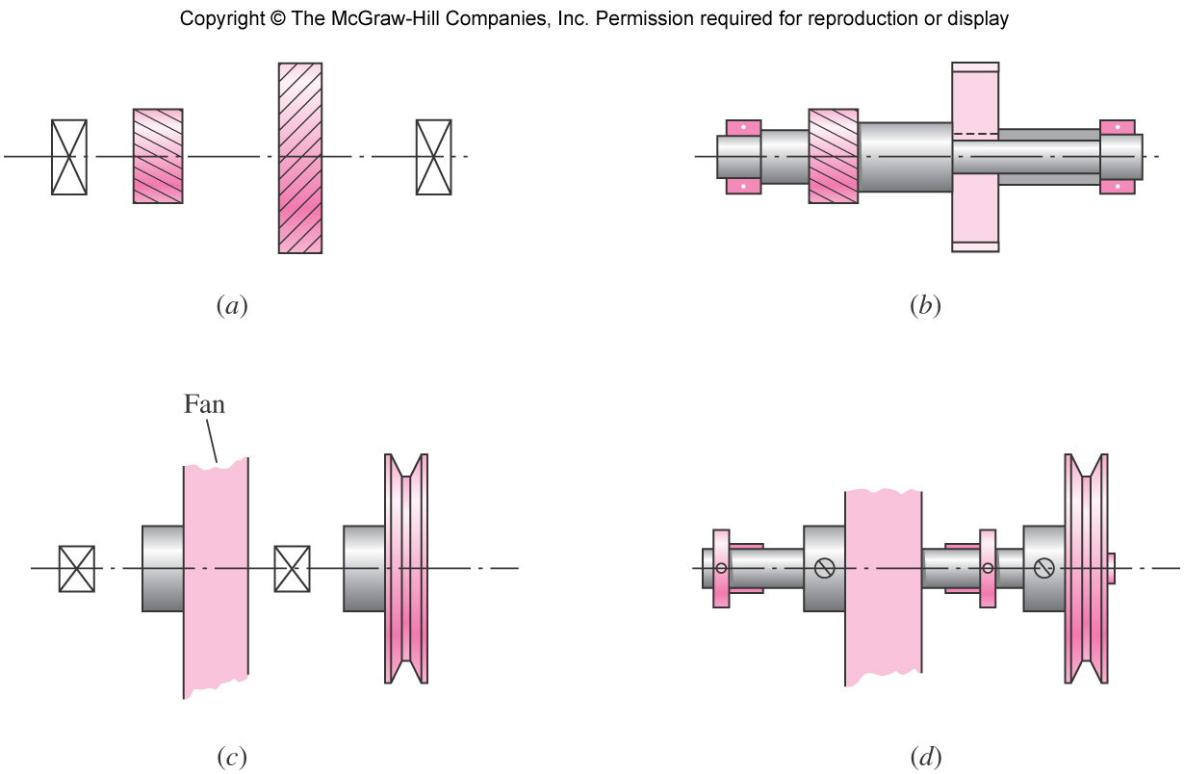
Axial Layout of Components
Fig. 7–2

Slide 9
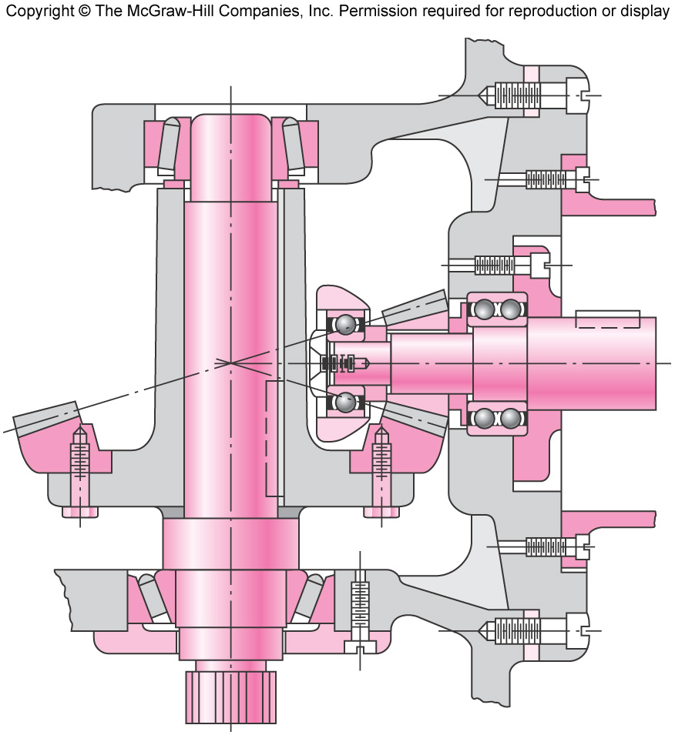
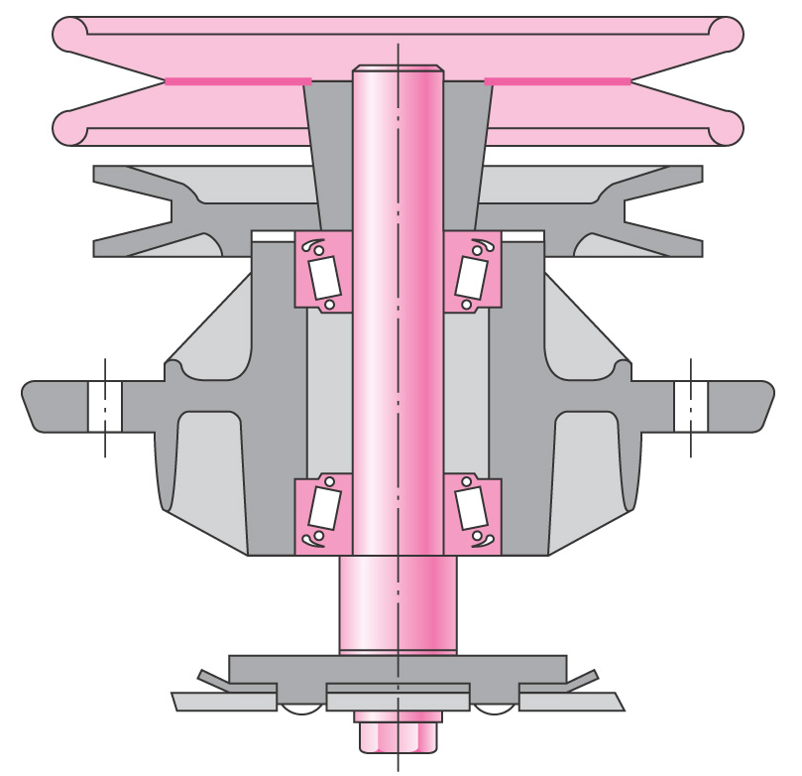
Supporting Axial Loads
Axial loads must be supported through a bearing to the frame.
Generally best for only one bearing to carry axial load to shoulder
Allows greater tolerances and prevents binding
Fig. 7–4
Fig. 7–3

Slide 10
Providing for Torque Transmission
Common means of transferring torque to shaft
Keys
Splines
Setscrews
Pins
Press or shrink fits
Tapered fits
Keys are one of the most effective
Slip fit of component onto shaft for easy assembly
Positive angular orientation of component
Can design key to be weakest link to fail in case of overload

Slide 11
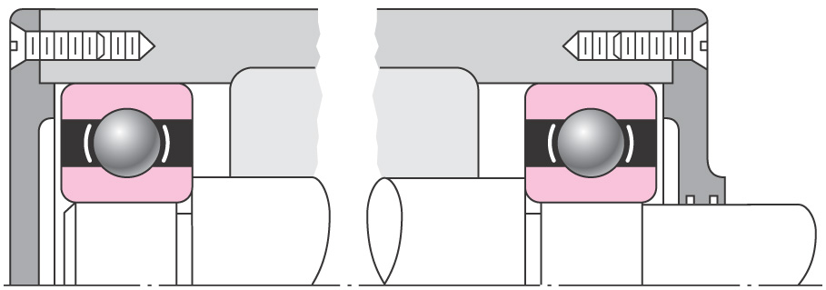
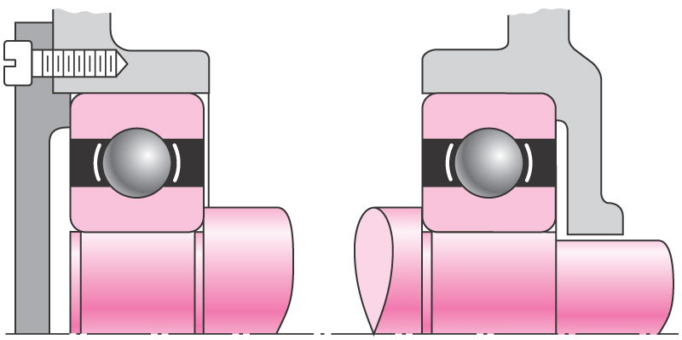
Assembly and Disassembly
Fig. 7–5
Fig. 7–6

Slide 12
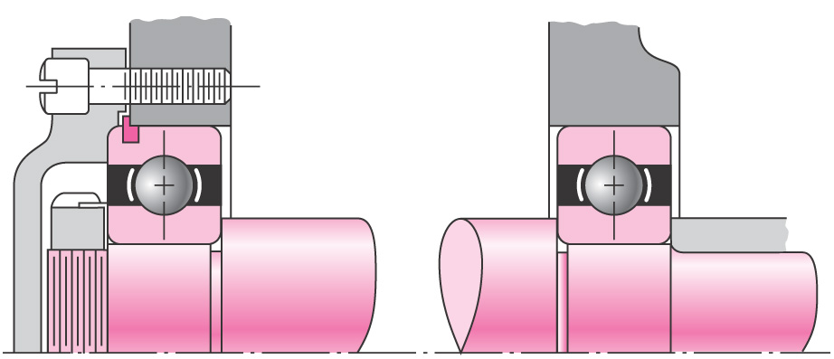
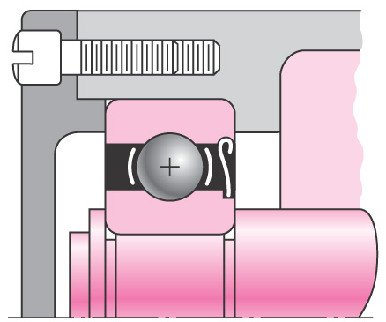
Assembly and Disassembly
Fig. 7–7
Fig. 7–8

Slide 13
Shaft Design for Stress
Stresses are only evaluated at critical locations
Critical locations are usually
On the outer surface
Where the bending moment is large
Where the torque is present
Where stress concentrations exist

Slide 14
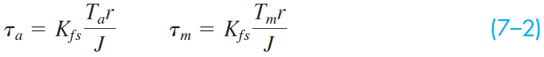
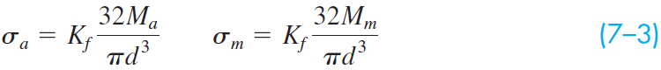
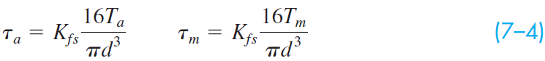
Shaft Stresses
Standard stress equations can be customized for shafts for convenience
Axial loads are generally small and constant, so will be ignored in this section
Standard alternating and midrange stresses
Customized for round shafts

Slide 15
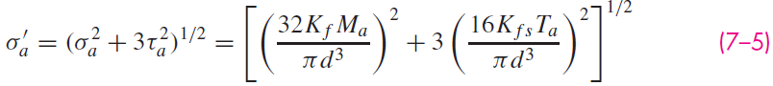
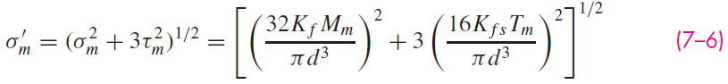
Shaft Stresses
Combine stresses into von Mises stresses

Slide 16
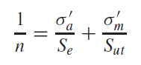
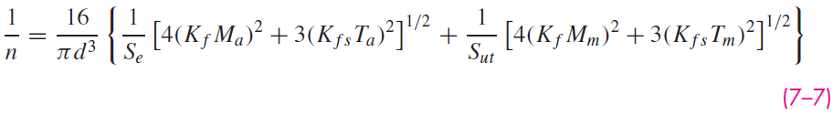
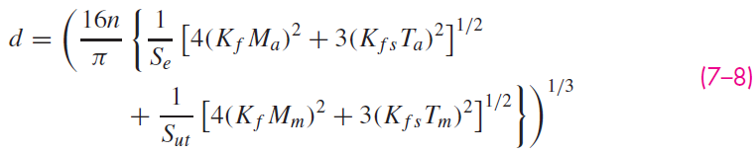
Shaft Stresses
Substitute von Mises stresses into failure criteria equation. For example, using modified Goodman line,
Solving for d is convenient for design purposes

Slide 17
Shaft Stresses
Similar approach can be taken with any of the fatigue failure criteria
Equations are referred to by referencing both the Distortion Energy method of combining stresses and the fatigue failure locus name. For example, DE-Goodman, DE-Gerber, etc.
In analysis situation, can either use these customized equations for factor of safety, or can use standard approach from Ch. 6.
In design situation, customized equations for d are much more convenient.

Slide 18
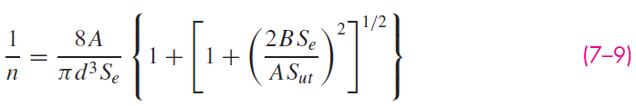
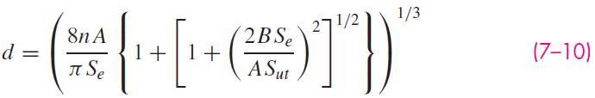
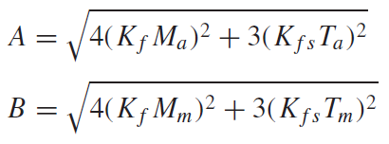
Shaft Stresses
DE-Gerber
where

Slide 19
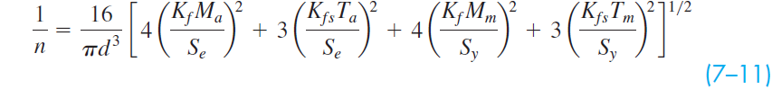
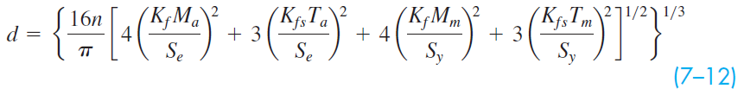
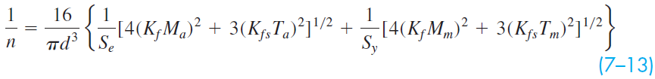
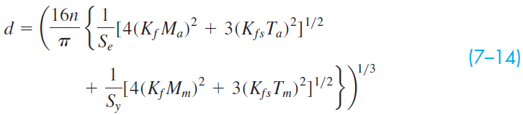
Shaft Stresses
DE-ASME Elliptic
DE-Soderberg

Slide 20
Shaft Stresses for Rotating Shaft
For rotating shaft with steady bending and torsion
Bending stress is completely reversed, since a stress element on the surface cycles from equal tension to compression during each rotation
Torsional stress is steady
Previous equations simplify with M_{m} and T_{a} equal to 0

Slide 21
Checking for Yielding in Shafts
Always necessary to consider static failure, even in fatigue situation
Soderberg criteria inherently guards against yielding
ASME-Elliptic criteria takes yielding into account, but is not entirely conservative
Gerber and modified Goodman criteria require specific check for yielding

Slide 22
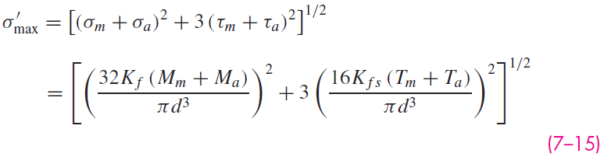
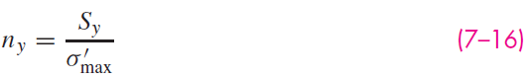
Checking for Yielding in Shafts
Use von Mises maximum stress to check for yielding,
Alternate simple check is to obtain conservative estimate of σ'_{max} by summing σ'_{a} and σ'_{m}

Slide 23
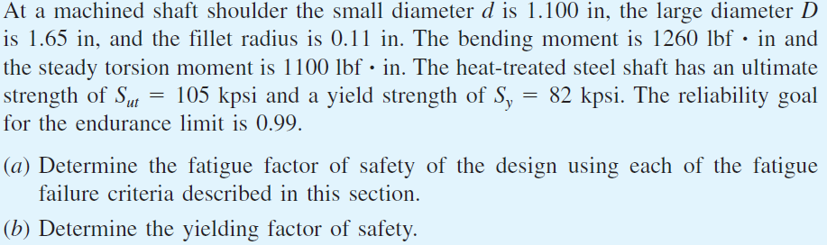
Example 7–1

Slide 24
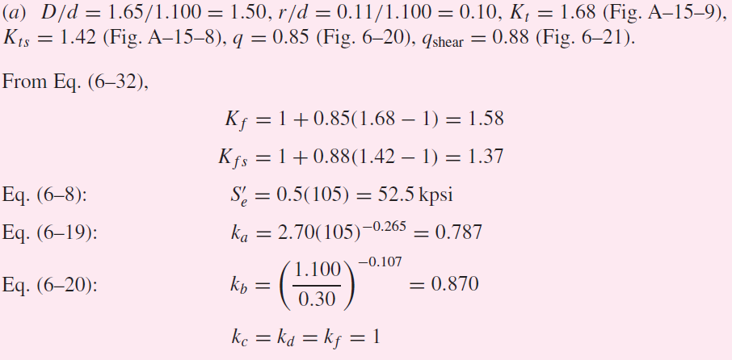
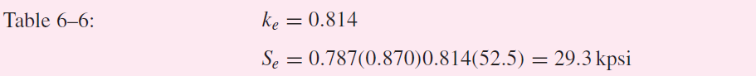
Example 7–1 (continued)

Slide 25
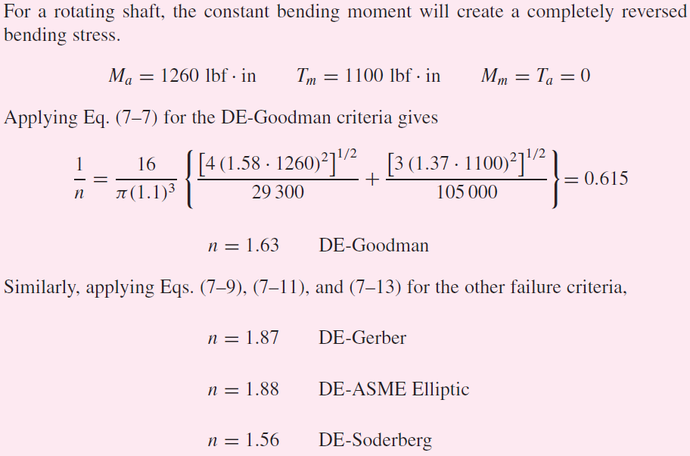
Example 7–1 (continued)

Slide 26
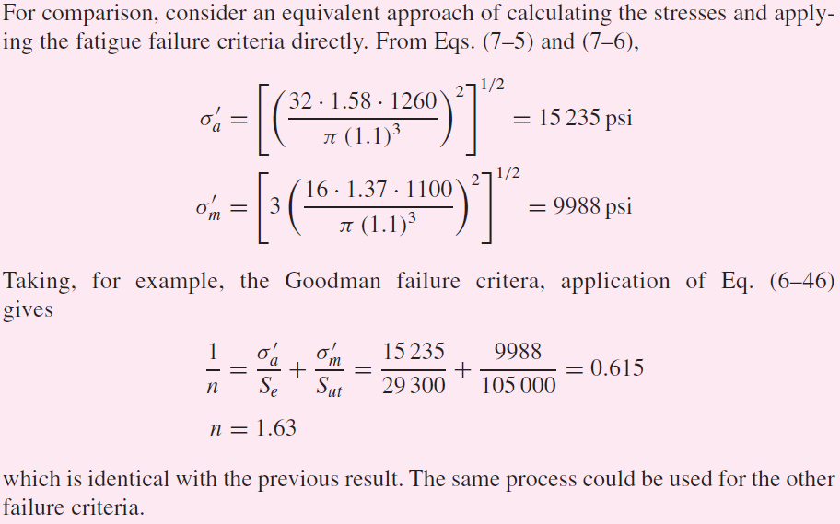
Example 7–1 (continued)

Slide 27
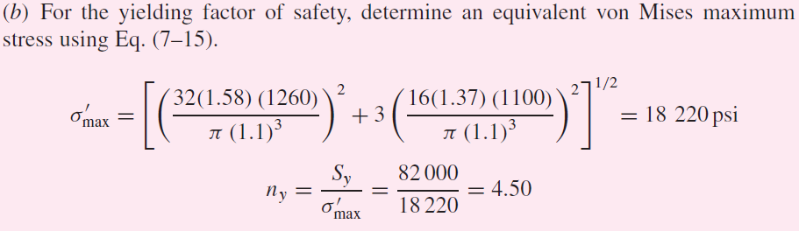
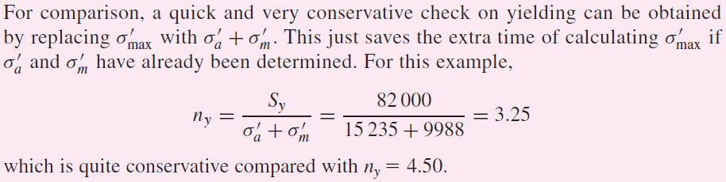
Example 7–1 (continued)

Slide 28
Estimating Stress Concentrations
Stress analysis for shafts is highly dependent on stress concentrations.
Stress concentrations depend on size specifications, which are not known the first time through a design process.
Standard shaft elements such as shoulders and keys have standard proportions, making it possible to estimate stress concentrations factors before determining actual sizes.

Slide 29
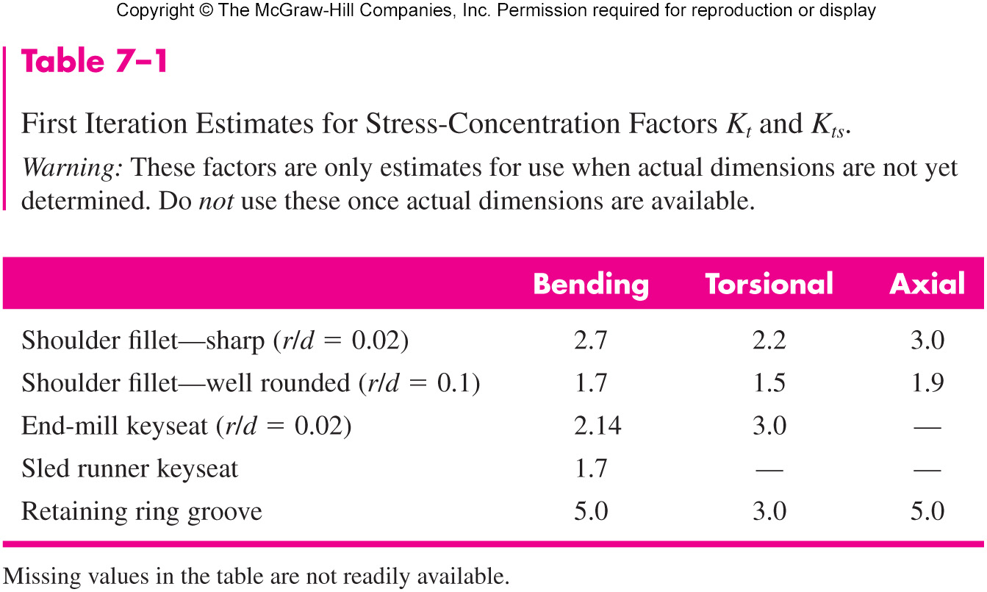
Estimating Stress Concentrations

Slide 30
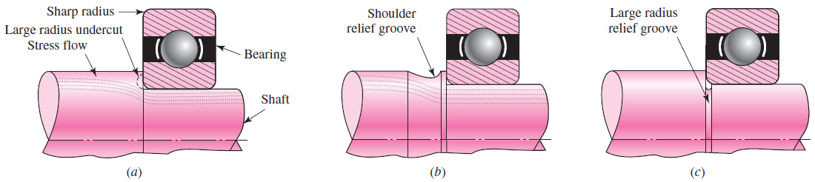
Reducing Stress Concentration at Shoulder Fillet
Bearings often require relatively sharp fillet radius at shoulder
If such a shoulder is the location of the critical stress, some manufacturing techniques are available to reduce the stress concentration
Large radius undercut into shoulder
Large radius relief groove into back of shoulder
Large radius relief groove into small diameter of shaft
Fig. 7–9

Slide 31
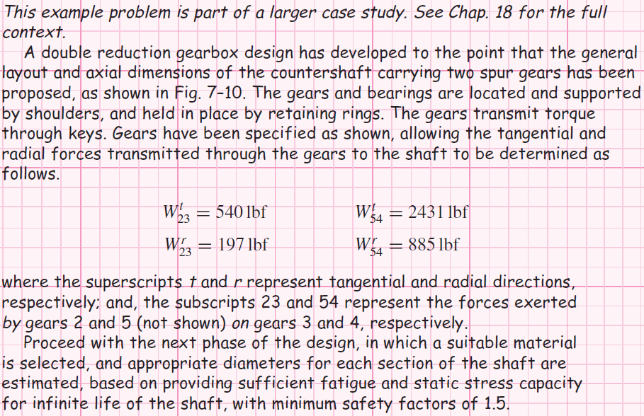
Example 7–2

Slide 32
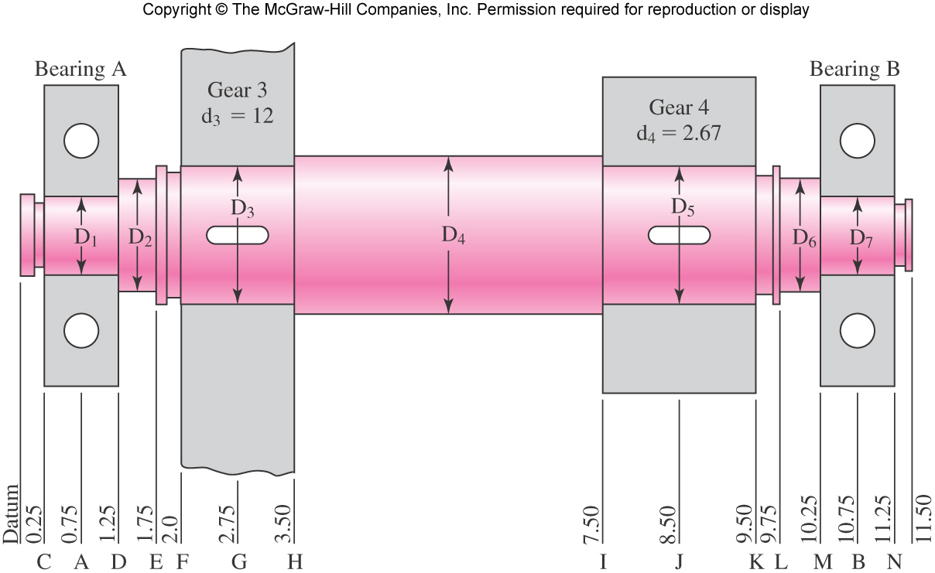
Example 7–2 (continued)
Fig. 7–10

Slide 33
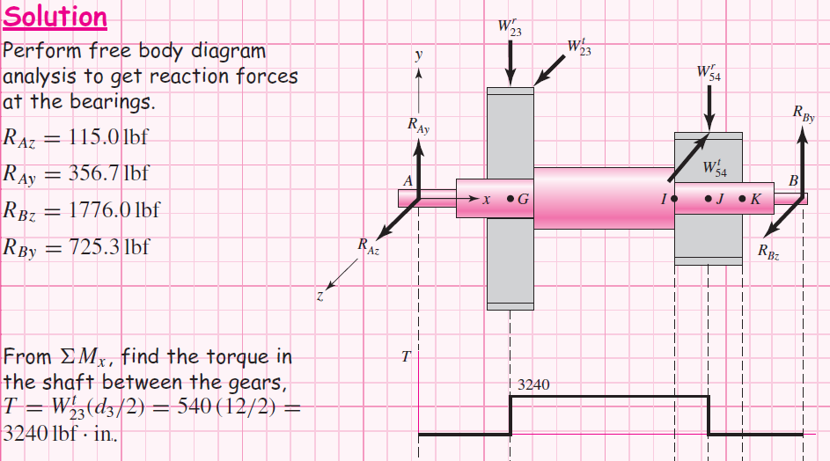
Example 7–2 (continued)

Slide 34
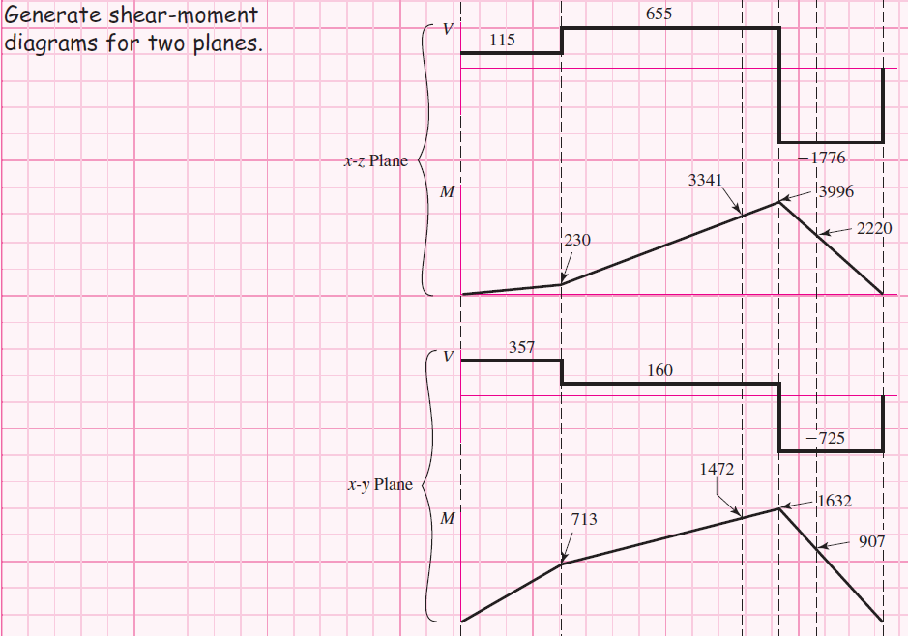
Example 7–2 (continued)

Slide 35
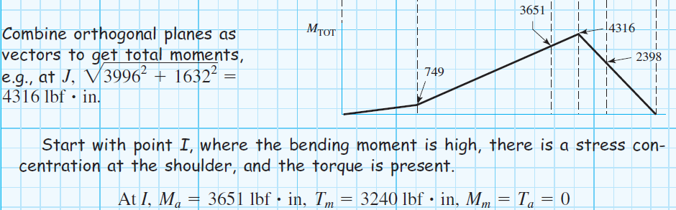
Example 7–2 (continued)

Slide 36
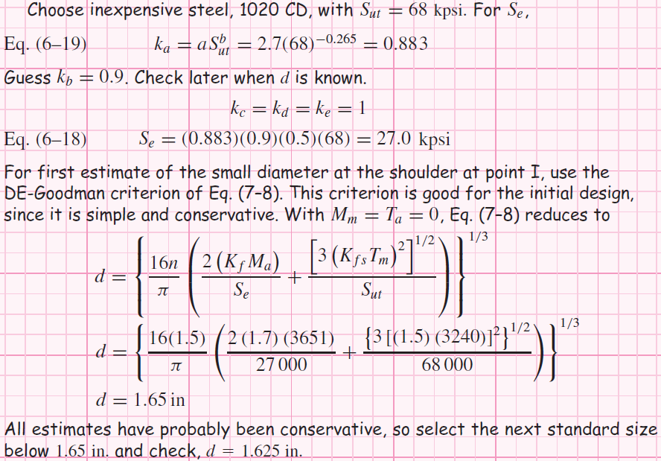
Example 7–2 (continued)

Slide 37
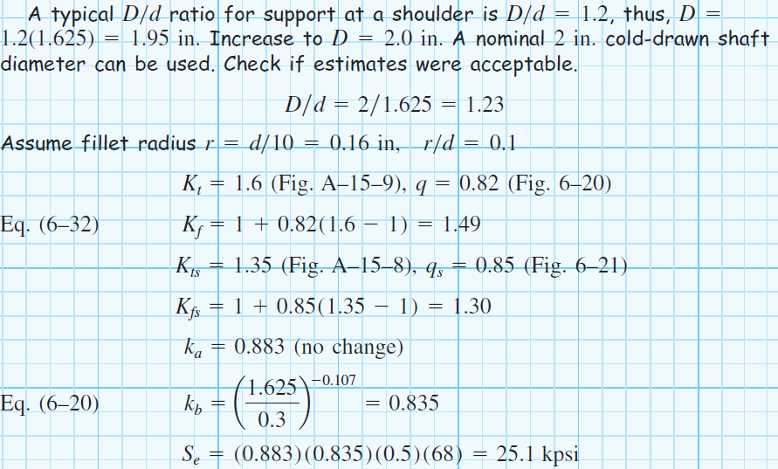
Example 7–2 (continued)

Slide 38
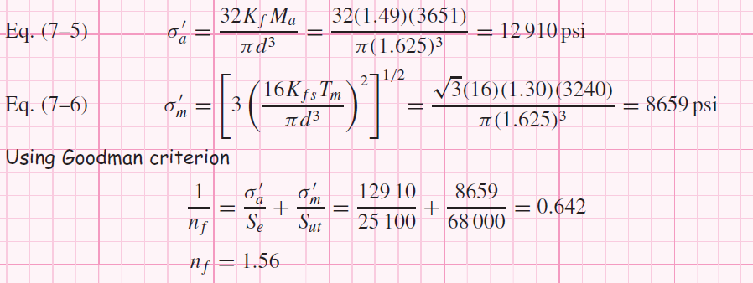
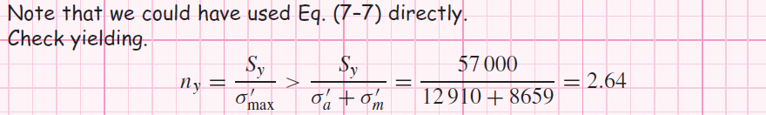
Example 7–2 (continued)

Slide 39
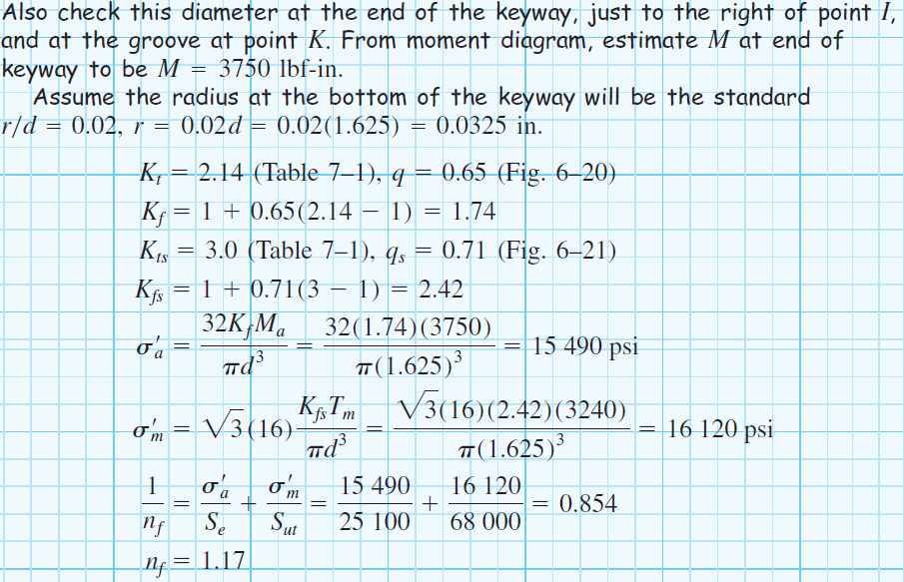
Example 7–2 (continued)

Slide 40
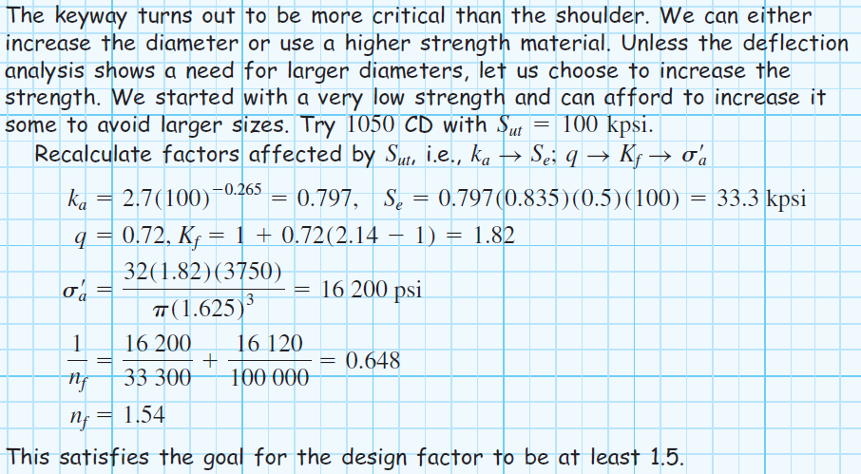
Example 7–2 (continued)

Slide 41
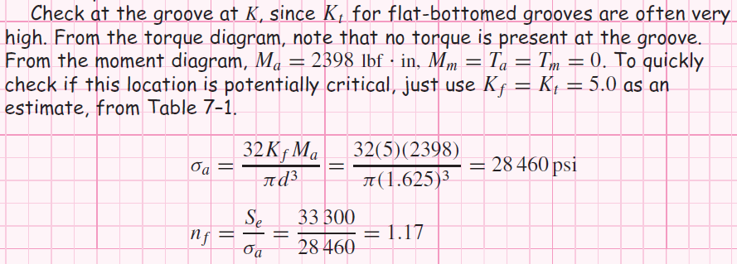
Example 7–2 (continued)

Slide 42
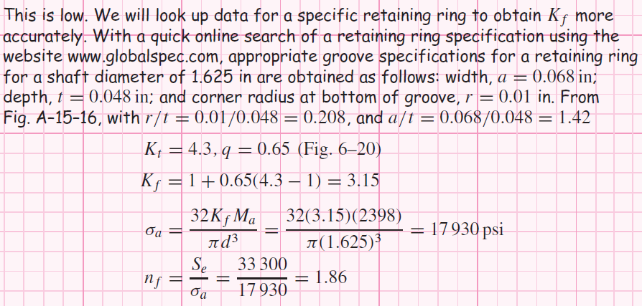
Example 7–2 (continued)

Slide 43
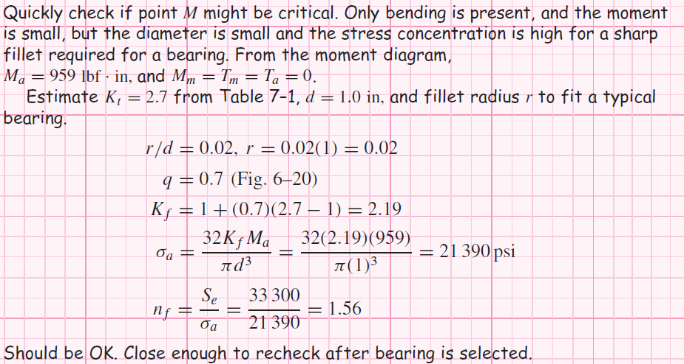
Example 7–2 (continued)

Slide 44

Example 7–2 (continued)

Slide 45
Deflection Considerations
Deflection analysis at a single point of interest requires complete geometry information for the entire shaft.
For this reason, a common approach is to size critical locations for stress, then fill in reasonable size estimates for other locations, then perform deflection analysis.
Deflection of the shaft, both linear and angular, should be checked at gears and bearings.

Slide 46

Deflection Considerations
Allowable deflections at components will depend on the component manufacturer’s specifications.
Typical ranges are given in Table 7–2

Slide 47
Deflection Considerations
Deflection analysis is straightforward, but lengthy and tedious to carry out manually.
Each point of interest requires entirely new deflection analysis.
Consequently, shaft deflection analysis is almost always done with the assistance of software.
Options include specialized shaft software, general beam deflection software, and finite element analysis software.

Slide 48


Example 7–3
Fig. 7–10

Slide 49

Example 7–3 (continued)

Slide 50

Example 7–3 (continued)
Fig. 7–11

Slide 51


Example 7–3 (continued)

Slide 52

Example 7–3 (continued)

Slide 53


Adjusting Diameters for Allowable Deflections
If any deflection is larger than allowed, since I is proportional to d⁴, a new diameter can be found from
Similarly, for slopes,
Determine the largest d_{new}/d_{old} ratio, then multiply all diameters by this ratio.
The tight constraint will be just right, and the others will be loose.

Slide 54





Example 7–4

Slide 55



Angular Deflection of Shafts
For stepped shaft with individual cylinder length l_{i} and torque T_{i}, the angular deflection can be estimated from
For constant torque throughout homogeneous material
Experimental evidence shows that these equations slightly underestimate the angular deflection.
Torsional stiffness of a stepped shaft is

Slide 56
Critical Speeds for Shafts
A shaft with mass has a critical speed at which its deflections become unstable.
Components attached to the shaft have an even lower critical speed than the shaft.
Designers should ensure that the lowest critical speed is at least twice the operating speed.

Slide 57


Critical Speeds for Shafts
For a simply supported shaft of uniform diameter, the first critical speed is
For an ensemble of attachments, Rayleigh’s method for lumped masses gives

Slide 58

Critical Speeds for Shafts
Eq. (7–23) can be applied to the shaft itself by partitioning the shaft into segments.
Fig. 7–12

Slide 59


Critical Speeds for Shafts
An influence coefficient is the transverse deflection at location I due to a unit load at location j.
From Table A–9–6 for a simply supported beam with a single unit load
Fig. 7–13

Slide 60



Critical Speeds for Shafts
Taking for example a simply supported shaft with three loads, the deflections corresponding to the location of each load is
If the forces are due only to centrifugal force due to the shaft mass,
Rearranging,

Slide 61



Critical Speeds for Shafts
Non-trivial solutions to this set of simultaneous equations will exist when its determinant equals zero.
Expanding the determinant,
Eq. (7–27) can be written in terms of its three roots as

Slide 62


Critical Speeds for Shafts
Comparing Eqs. (7–27) and (7–28),
Define ω_{ii} as the critical speed if m_{i} is acting alone. From Eq. (7–29),
Thus, Eq. (7–29) can be rewritten as

Slide 63



Critical Speeds for Shafts
Note that
The first critical speed can be approximated from Eq. (7–30) as
Extending this idea to an n-body shaft, we obtain Dunkerley’s equation,

Slide 64

Critical Speeds for Shafts
Since Dunkerley’s equation has loads appearing in the equation, it follows that if each load could be placed at some convenient location transformed into an equivalent load, then the critical speed of an array of loads could be found by summing the equivalent loads, all placed at a single convenient location.
For the load at station 1, placed at the center of the span, the equivalent load is found from

Slide 65


Example 7–5
Fig. 7–14

Slide 66



Example 7–5 (continued)

Slide 67

Example 7–5 (continued)

Slide 68

Example 7–5 (continued)

Slide 69


Example 7–5 (continued)
Fig. 7–14

Slide 70

Example 7–5 (continued)

Slide 71

Example 7–5 (continued)

Slide 72

Setscrews
Setscrews resist axial and rotational motion
They apply a compressive force to create friction
The tip of the set screw may also provide a slight penetration
Various tips are available
Fig. 7–15

Slide 73

Setscrews
Resistance to axial motion of collar or hub relative to shaft is called holding power
Typical values listed in Table 7–4 apply to axial and torsional resistance
Typical factors of safety are 1.5 to 2.0 for static, and 4 to 8 for dynamic loads
Length should be about half the shaft diameter

Slide 74

Keys and Pins
Used to secure rotating elements and to transmit torque
Fig. 7–16

Slide 75

Tapered Pins
Taper pins are sized by diameter at large end
Small end diameter is
Table 7–5 shows some standard sizes in inches
Table 7–5

Slide 76

Keys
Keys come in standard square and rectangular sizes
Shaft diameter determines key size
Table 7–6

Slide 77
Keys
Failure of keys is by either direct shear or bearing stress
Key length is designed to provide desired factor of safety
Factor of safety should not be excessive, so the inexpensive key is the weak link
Key length is limited to hub length
Key length should not exceed 1.5 times shaft diameter to avoid problems from twisting
Multiple keys may be used to carry greater torque, typically oriented 90º from one another
Stock key material is typically low carbon cold-rolled steel, with dimensions slightly under the nominal dimensions to easily fit end-milled keyway
A setscrew is sometimes used with a key for axial positioning, and to minimize rotational backlash

Slide 78

Gib-head Key
Gib-head key is tapered so that when firmly driven it prevents axial motion
Head makes removal easy
Projection of head may be hazardous
Fig. 7–17

Slide 79

Woodruff Key
Woodruff keys have deeper penetration
Useful for smaller shafts to prevent key from rolling
When used near a shoulder, the keyway stress concentration interferes less with shoulder than square keyway
Fig. 7–17

Slide 80

Woodruff Key

Slide 81

Woodruff Key

Slide 82
Stress Concentration Factors for Keys
For keyseats cut by standard end-mill cutters, with a ratio of r/d = 0.02, Peterson’s charts give
K_{t} = 2.14 for bending
K_{t} = 2.62 for torsion without the key in place
K_{t} = 3.0 for torsion with the key in place
Keeping the end of the keyseat at least a distance of d/10 from the shoulder fillet will prevent the two stress concentrations from combining.

Slide 83


Example 7–6
Fig. 7–19

Slide 84

Example 7–6 (continued)

Slide 85

Example 7–6 (continued)

Slide 86

Retaining Rings
Retaining rings are often used instead of a shoulder to provide axial positioning
Fig. 7–18

Slide 87
Retaining Rings
Retaining ring must seat well in bottom of groove to support axial loads against the sides of the groove.
This requires sharp radius in bottom of groove.
Stress concentrations for flat-bottomed grooves are available in Table A–15–16 and A–15–17.
Typical stress concentration factors are high, around 5 for bending and axial, and 3 for torsion

Slide 88
Limits and Fits
Shaft diameters need to be sized to “fit” the shaft components (e.g. gears, bearings, etc.)
Need ease of assembly
Need minimum slop
May need to transmit torque through press fit
Shaft design requires only nominal shaft diameters
Precise dimensions, including tolerances, are necessary to finalize design

Slide 89

Tolerances
Close tolerances generally increase cost
Require additional processing steps
Require additional inspection
Require machines with lower production rates
Fig. 1–2

Slide 90
Standards for Limits and Fits
Two standards for limits and fits in use in United States
U.S. Customary (1967)
Metric (1978)
Metric version will be presented, with a set of inch conversions

Slide 91

Nomenclature for Cylindrical Fit
Upper case letters refer to hole
Lower case letters refer to shaft
Basic size is the nominal diameter and is same for both parts, D=d
Tolerance is the difference between maximum and minimum size
Deviation is the difference between a size and the basic size
Fig. 7–20

Slide 92
Tolerance Grade Number
Tolerance is the difference between maximum and minimum size
International tolerance grade numbers designate groups of tolerances such that the tolerances for a particular IT number have the same relative level of accuracy but vary depending on the basic size
IT grades range from IT0 to IT16, but only IT6 to IT11 are generally needed
Specifications for IT grades are listed in Table A–11 for metric series and A–13 for inch series

Slide 93

Tolerance Grades – Metric Series
Table A–11

Slide 94

Tolerance Grades – Inch Series
Table A–13

Slide 95
Deviations
Deviation is the algebraic difference between a size and the basic size
Upper deviation is the algebraic difference between the maximum limit and the basic size
Lower deviation is the algebraic difference between the minimum limit and the basic size
Fundamental deviation is either the upper or lower deviation that is closer to the basic size
Letter codes are used to designate a similar level of clearance or interference for different basic sizes

Slide 96
Fundamental Deviation Letter Codes
Shafts with clearance fits
Letter codes c, d, f, g, and h
Upper deviation = fundamental deviation
Lower deviation = upper deviation – tolerance grade
Shafts with transition or interference fits
Letter codes k, n, p, s, and u
Lower deviation = fundamental deviation
Upper deviation = lower deviation + tolerance grade
Hole
The standard is a hole based standard, so letter code H is always used for the hole
Lower deviation = 0 (Therefore D_{min} = 0)
Upper deviation = tolerance grade
Fundamental deviations for letter codes are shown in Table A–12 for metric series and A–14 for inch series

Slide 97

Fundamental Deviations – Metric series
Table A–12

Slide 98

Fundamental Deviations – Inch series
Table A–14

Slide 99
Specification of Fit
A particular fit is specified by giving the basic size followed by letter code and IT grades for hole and shaft.
For example, a sliding fit of a nominally 32 mm diameter shaft and hub would be specified as 32H7/g6
This indicates
32 mm basic size
hole with IT grade of 7 (look up tolerance ΔD in Table A–11)
shaft with fundamental deviation specified by letter code g (look up fundamental deviation δ_{F} in Table A–12)
shaft with IT grade of 6 (look up tolerance Δd in Table A–11)
Appropriate letter codes and IT grades for common fits are given in Table 7–9

Slide 100

Description of Preferred Fits (Clearance)
Table 7–9

Slide 101
Description of Preferred Fits (Transition & Interference)
Table 7–9

Slide 102
Procedure to Size for Specified Fit
Select description of desired fit from Table 7–9.
Obtain letter codes and IT grades from symbol for desired fit from Table 7–9
Use Table A–11 (metric) or A–13 (inch) with IT grade numbers to obtain ΔD for hole and Δd for shaft
Use Table A–12 (metric) or A–14 (inch) with shaft letter code to obtain δ_{F} for shaft
For hole
For shafts with clearance fits c, d, f, g, and h
For shafts with interference fits k, n, p, s, and u

Slide 103

Example 7–7

Slide 104


Example 7–8

Slide 105
Stress in Interference Fits
Interference fit generates pressure at interface
Need to ensure stresses are acceptable
Treat shaft as cylinder with uniform external pressure
Treat hub as hollow cylinder with uniform internal pressure
These situations were developed in Ch. 3 and will be adapted here

Slide 106


Stress in Interference Fits
The pressure at the interface, from Eq. (3–56) converted into terms of diameters,
If both members are of the same material,
δ is diametral interference
Taking into account the tolerances,

Slide 107


Stress in Interference Fits
From Eqs. (3–58) and (3–59), with radii converted to diameters, the tangential stresses at the interface are
The radial stresses at the interface are simply
The tangential and radial stresses are orthogonal and can be combined using a failure theory

Slide 108

Torque Transmission from Interference Fit
Estimate the torque that can be transmitted through interference fit by friction analysis at interface
Use the minimum interference to determine the minimum pressure to find the maximum torque that the joint should be expected to transmit.

